Slide 1
Islamophobia
By Dr. Monia Mazigh
2017 ©

Slide 2
Introduction
What does Islamophobia mean?
Is it a new or an old concept?
Is it real or is it simply a myth created by some to ban freedom of expression

Slide 3
What does Islamophobia mean?

Slide 4
Oxford English Dictionary
Islamophobia: (introduced since 1923)
It is an intense dislike or fear of Islam, especially as a political force; hostility or prejudice towards Muslims

Slide 5
In the Runnymede Trust Report, the Commission on British Muslims and Islamophobia (1996)
Islamophobia is an outlook or world-view involving an unfounded dread and dislike of Muslims, which results in practices of exclusion and discrimination

Slide 6
Old or New?
The word Islamophobia did not enter into “common parlance” until early 90’s.
Patel, Humphries and Naik (1998) claim that Islamophobia has always been present in Western countries and cultures. In the last two decades, it has become accentuated, explicit and extreme”

Slide 7
Alphonse-Étienne Dinet (1861 -1929) Orientalist Painter
He is considered as the first author who has used and introduced the word Islamophobia in an essay in L’Orient vu de l’Occident in 1922

Slide 8
Survey: Canada in 2017
47% of Canadians support banning headscarves in public (compared with 30% of Americans)
51% support government surveillance of mosques (as compared to 46% of Americans)
31% of Canadians approve of American President Donald Trump’s restrictions on travellers from Muslim-majority countries

Slide 9
Survey: Canada in 2017
46% of Canadians have an unfavourable view of Islam – more than for any other religious tradition;
Fewer than half of Canadians would find it “acceptable” for one of their children to marry a Muslim – lower than for any other religious group
http://angusreid.org/religious-trends-2017/.

Slide 10
Survey: Canada in 2017
56% of Canadians believe that Islam suppresses women’s rights
more than half of people living in Ontario feel mainstream Muslim doctrines promote violence
52% of Canadians feel that Muslims can only be trusted “a little” or “not at all”
42% of Canadians think discrimination against Muslims is “mainly their fault”

Slide 11
Hate Crimes in Canada ( Statistics 2016)
A general increase of 3% in 2016 compared to 2015
1409 hate crime cases
Province of Quebec registered the highest increase: 327 hate crimes have been committed in 2016
A 21 % increase compared to 2015
This increase is attributed to higher numbers of crimes targeting: Arabs, West Asian, Jewish population and reasons related to sexual orientation

Slide 12
Islamophobia
Media
Laws
Politics

Slide 13
Media
A study of the Globe and Mail by communication studies professor Yasmin Jiwani found sixty-six articles on the Shafia case alone (which was widely represented as an “honour killing”), but only fifty-nine on the “murder of women and domestic violence” in general from 2005 to 2012.

Slide 14
Media
In one week toward the end of the 2015 federal election, the niqab issue was mentioned in at least 133 online articles between the National Post, Toronto Star, and Globe and Mail, compared to just 102 for the Trans-Pacific Partnership

Slide 15
Media Bias
American media watchdog organization Fairness and Accuracy in Reporting (FAIR) found that the 2017 Quebec mosque shooting received six times less coverage in American media than the 2014 Parliament Hill attack by Michael Zehaf-Bibeau, even though the mosque shooting involved six times more deaths

Slide 16
Double standards
the Quebec mosque shooting (January 2017) received approximately five minutes of airtime on CBC’s flagship news program, The National, the night that it occurred – while the London Borough attacks in the UK (June 2017) received several hours of live reportage and commentary.

Slide 17
The War on Terror (2001)
Anti- Terrorism Act 2001(Bill C-36)
Security Certificate targeting Muslim men
Anti-Terrorism Act 2015 (Bill C-51)

Slide 18
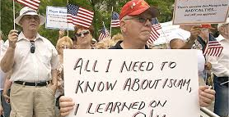
Linking Islam to Terrorism

Slide 19
A Plan to Attack Veterans Affairs Office
January 2014, Glen Gieschen, was arrested
The bag contained a .40-calibre semi-automatic handgun that was loaded with a full magazine. Police also recovered a .308-calibre rifle, a ballistic range-finder scope for shooting long distances, a laser sight for shooting at close range, night-vision binoculars and 1,000 pounds of ammunition.

Slide 20
One of the Most Heinous Crimes in Canadian history
In June 2014, Justin Bourque, 24 year old, shoot 3 RCMP officers in Moncton, New Brunswick and severely injuring two.

Slide 21
A “Group of Murderous Misfit”
Between Feb12, and Feb. 14, 2015,
Three young people Lindsay Souvannarath, Randall Shepherd, and James Gamble were getting ready to commit a mass killing plot in Halifax Shopping Centre.
Neo-Nazi, Columbine Massacre admirers

Slide 22
Alexandre Bissonnette, a shy, timid and an introvert
On January 29, 2017, Bissonnette killed in cold blood six men in the Quebec City Mosque and injured 19 others.
Early October 2017, the Crown announced in Quebec City that Alexandre Bissonnette, will not face terrorism charges when he eventually goes to trial before a judge and jury.

Slide 23
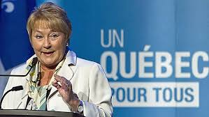
Identity Politics

Slide 24
The Reasonable Accommodations Debate in Quebec (2008)
Muslims ask for special treatment in pools
Muslims ask for special treatment in Sugar shacks

Slide 25
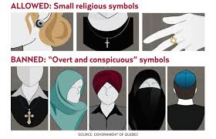
The Charter of Values (2013)

Slide 26
Canadian Senate Committee February 2015
Senator Lynn Beyak to Shahina Siddiqui
"I just wanted to say that comments I get from constituents all the time is that we all have to stop being offended. Stop being thin skinned and work together. They're tired of hearing excuses”

Slide 27
The same Senate Committee June 2015
Ayaan Hirsi Ali testified before the same Senate Committee
The same Committee did not discuss the fact that Hirsi Ali has in the past cited the religion of Islam as a “nihilistic cult of death”, the “greatest possible danger to world peace”, has called for war on Islam rather than on radical Islamists, and compared the religion to Nazism

Slide 28
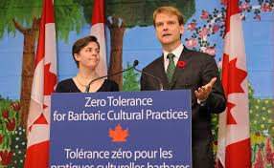
Barbaric Culture Practices

Slide 29
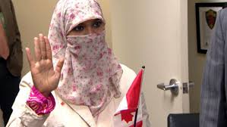
The Niqab election 2015

Slide 30
Real Consequences of Islamophobia

Slide 31
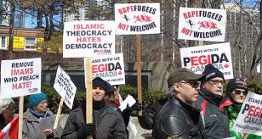
First Protest of PEGIDA (Patriotic Europeans Against the Islamisation of the West) Sept. 2015 Toronto

Slide 32
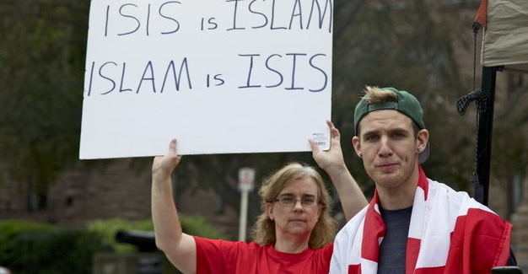
September 19, 2015 in Toronto

Slide 33
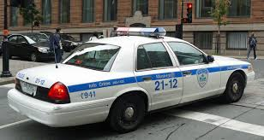
Muslim pregnant woman attacked in Montreal Oct. 2015

Slide 34
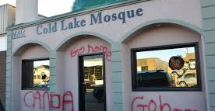
Cold Lake Mosque vandalized Nov. 2015

Slide 35
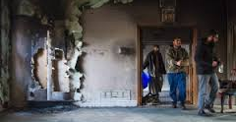
Peterborough Mosque attacked Nov. 2015

Slide 36
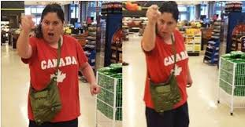
Muslim woman attacked in London, Ontario, June 2016

Slide 37
Quebec City Mosque Vandalized summer 2016
Swastikas had been spray-painted on the walls of the mosque and a gift-wrapped pig’s head was left on the doorstep of the mosque during Ramadan, with a note reading “bon appétit”.

Slide 38
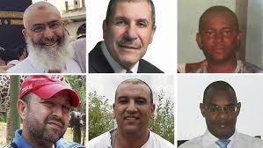
Quebec City Shooting, Jan. 2017

Slide 39
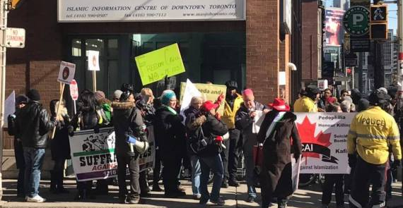
Toronto Mosque Protest February 2017

Slide 40
Report on Hate crimes 2013
The 2013 report on police-reported hate crimes shows that overall, there was a 17 per cent drop in the number of hate crimes reported to police in Canada compared to during 2012: from 1,414 to 1,167.

Slide 41
Hate Crimes
There were 159 police-reported hate crimes against Muslims in 2015, according to the most recent Statistics Canada data available. The number of anti-Muslim hate crimes more than tripled between 2012 to 2015, even as the overall incidence of hate crimes declined. As compared to other groups targeted by hate, Muslims had the highest percentage of women victims (53%).

Slide 42
Statistics
Although the total number of religiously-motivated hate crime incidents reported in 2013 dropped by 22 per cent, the Muslim population was the only group to see an increase in the number of hate crimes reported against them, with the number of reported incidents increasing to 45 to 65.

Slide 43
Statistics
Canadian Muslims were the only religious group that experienced an increase in hate crimes in 2013 according to new numbers released by Statistics Canada — and community leaders say things have only gotten worse over 2014 with the rise of ISIS and toxic political rhetoric.

Slide 44
Statistics
Within just three years, the number of police-reported hate crimes against Muslims in Canada more than doubled, from 45 in 2012 to 99 in 2014, according to Statistics Canada.

Slide 45
Incidents on Canadian Universities
In 2016, the media at Durham College and the University of Ontario Institute of Technology were defaced.
Fall 2016, anti-Muslim flyers appeared at McGill University and the University of Calgary
Less public but disturbing incidents have targeted individuals. Anti-Muslim insults were written on student-election posters at the University of Ottawa.
January 2017, A young woman at Simon Fraser University was told to remove her hijab.

Slide 46
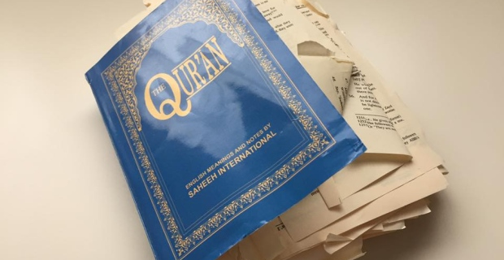
Quran destroyed at a peel District School Board meeting in March 2017

Slide 47
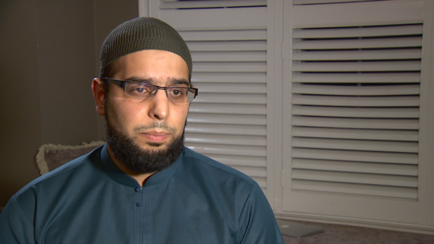
Peel Imam received death threat for religious accomodation in schools August 2017

Slide 48
The Reaction Against M-103
Mississauga, Ont. MP Iqra Khalid told the House of Commons Thursday she received more than 50,000 emails in response to M-103, many of them with overt discrimination or direct threats.

Slide 49
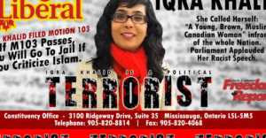
Politically: Motion#103 by Iqra Khaled

Slide 50
From the “hate emails”
"Kill her and be done with it. I agree she is here to kill us. She is sick and she needs to be deported."
"We will burn down your mosques, draper head Muslim."
"Why did Canadians let her in? Ship her back."
"Why don't you get out of my country? You're a disgusting piece of trash and you are definitely not wanted here by the majority of actual Canadians."

Slide 51
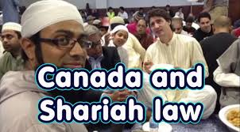
Creeping Sharia

Slide 52
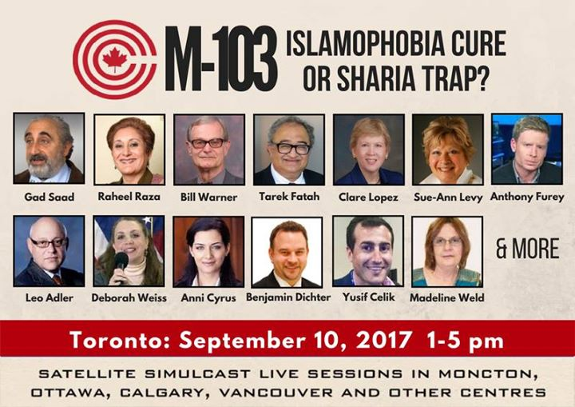
Sharia Trap

Slide 53
Free Speech Not Sharia
https://www.youtube.com/watch?time_continue=63&v=b6BYHsebbPk

Slide 54
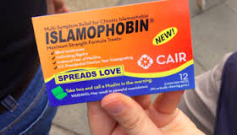
How to fight Islamophobia?

Slide 55
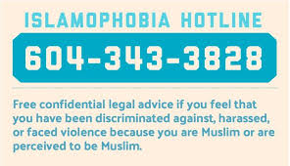
Legally: Challenges and Hate Crime Prosecutions

Slide 56
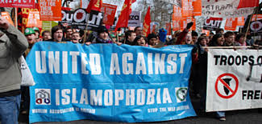
Education and solidarity

Slide 57
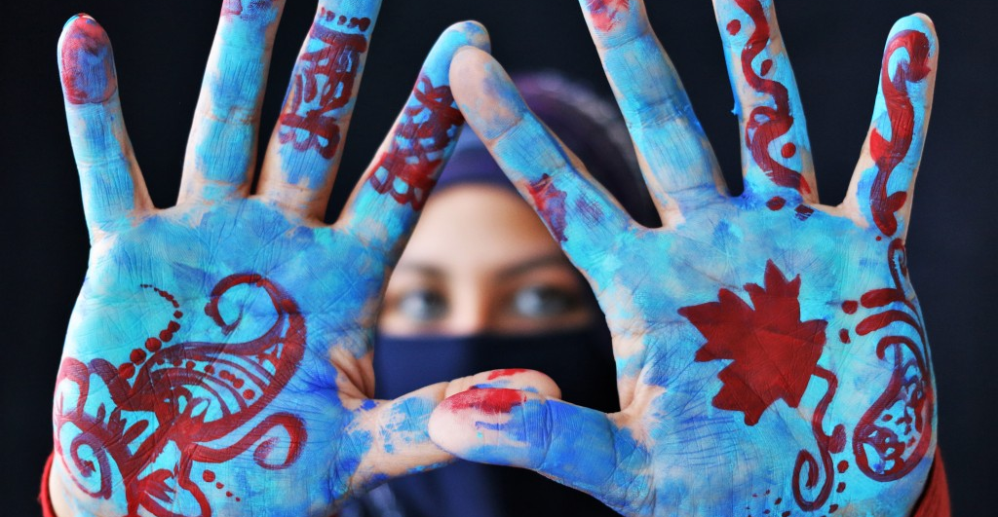
Reclaiming the Narrative

Slide 58

Your Thoughts…

